Slide 1

Web service design
Designing web services
RESTful APIs
Other design approaches
GraphQL

Slide 2
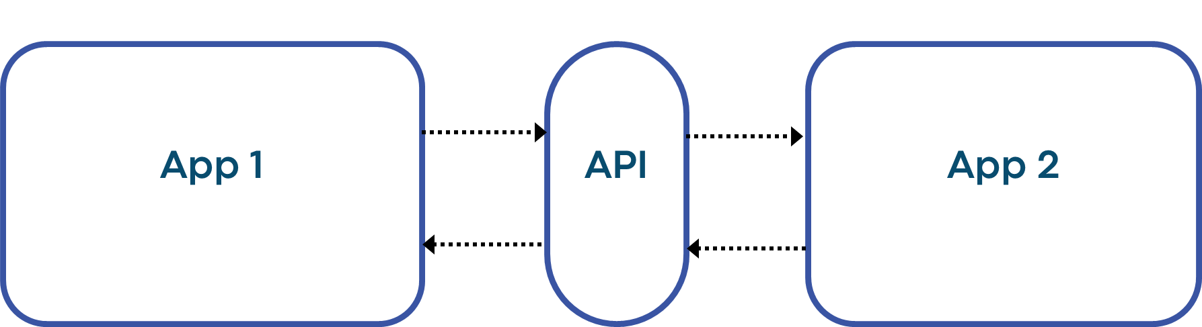
API
Programming interface between two applications / systems / servers
Notes:
Example: getCustomer(cid), getOrder(ord), getProduct(pid), …

Slide 3
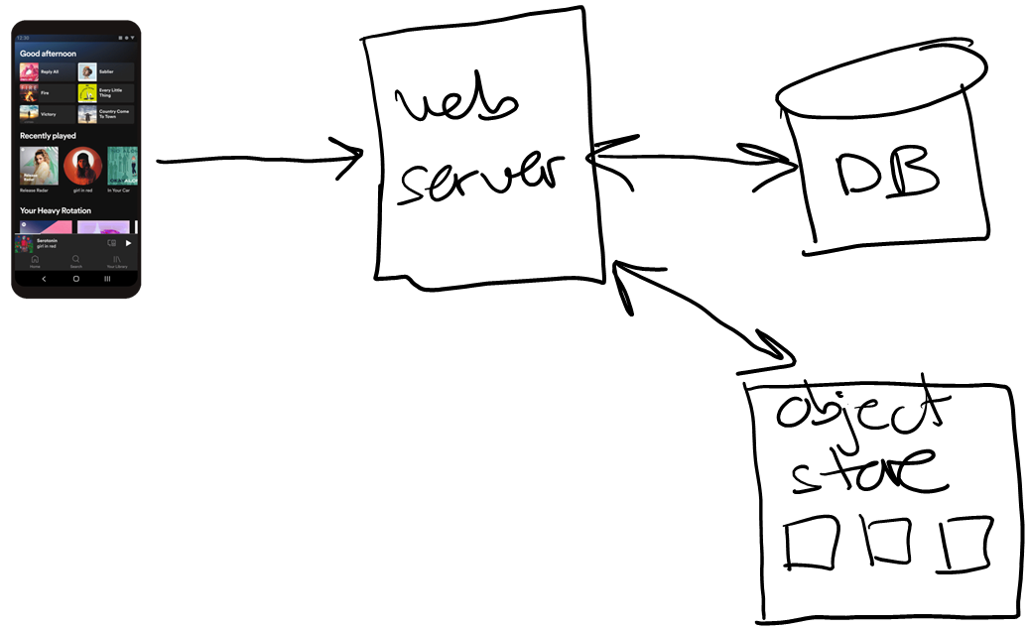
Example: Project 02
//
// PhotoApp web service
//
app.get('/stats', (req, res) => {…});
app.get('/users', (req, res) => {…});
app.get('/assets', (req, res) => {…});
app.get('/bucket', (req, res) => {…});
app.get('/image/:assetid', (req, res) => {…});
.
.
.
Notes:
The last get is an image download…

Slide 4
Design question
We are developing a social media application
Our API needs to support a user "liking" an image. But a user can only like an image once, if they say they like the same image again and again, the result should still be just one "like".
How would you design this functionality in the API?
app.get('/like/image/:userid/:imageid', (req, res) => {
...
});
(A)
app.put('/like/image/:userid/:imageid', (req, res) => {
...
});
(B)
app.post('/like/image/:userid/:imageid', (req, res) => {
...
});
(C)

Slide 5
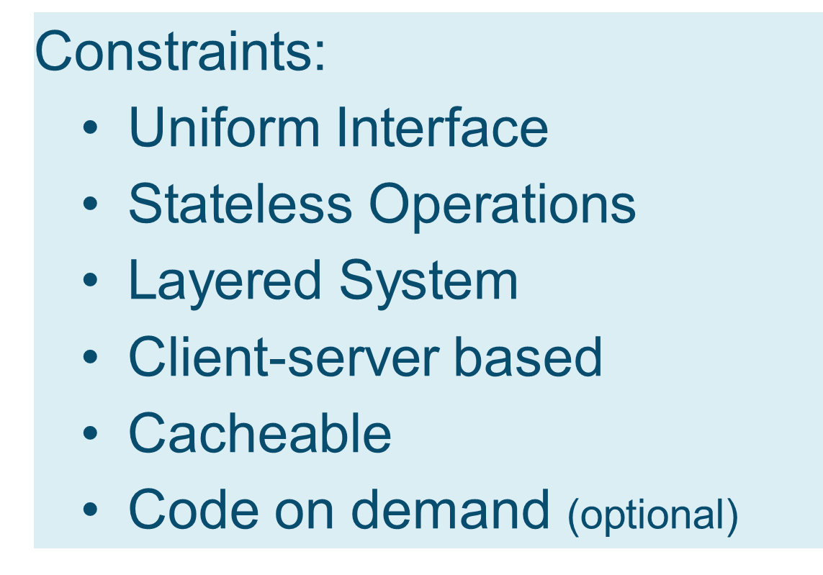
RESTful API
Many web service APIs are said to be "RESTful"
This is an architectural style with design constraints:
Notes:
"Uniform interface that adheres to web server standards"

Slide 6
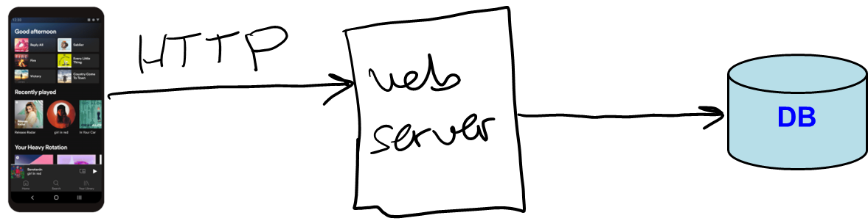
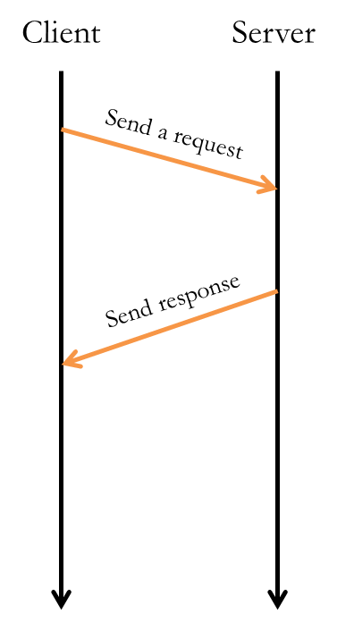
RESTful APIs
REST = REpresentational State Transfer (PhD research)
RESTful APIs are supposed to follow HTTP rules, and thus better integrate into web infrastructures
any function called via HTTP get should be idempotent, i.e. compute the same result given the same system state
==> no side-effects
calling an idempotent function over and over again is supposed to be safe, and return the same value to support caching in servers closer to client
Why would a request be repeated? If client doesn't get a timely response, they are allowed to repeat without causing side-effects…
6

Slide 7
Example
RESTful API for a social media app
1. Uniform Interface
Endpoints refer to one resource
2. Stateless Operations
All info that my server needs to know should be in the request
Doesn’t need info from a previous request
/users
/users/:userid
/posts
/posts/:postid
/posts/1/1000
/posts/1001/2000
Notes:
"Uniform interface that adheres to web server standards"

Slide 8
Example: deleting a post?
We are developing a social media application
We are using HTTP DELETE to implement API function so users can delete their most recent post. Is design good or bad?
This is a bad design because DELETE should be idempotent
With above design, repeated calls will keep deleting more and more posts
Better design? Uniquely identify the post to delete, so repeated calls have no effect:
app.delete('/user/feed/posts/last/:userid', (req, res) => {
.
.
.
});
app.delete('/user/feed/posts/:userid/:postid', (req, res) => {
.
.
.
});

Slide 9
HTTP requests and responses
Request methods:
Response codes
GET: to request data, if repeated should return the same data
PUT: to put data on the server, if repeated should have same effect
POST: to post data to the server, if repeated treat as new data
DELETE: to remove data from the server, if repeated should have the same effect
200 OK: success
301 Moved Permanently: redirects to another URL
400 Bad Request: invalid client request
403 Forbidden: lack permission
404 Not Found: URL is bad
500 Internal Server Error
… and many more
9

Slide 10
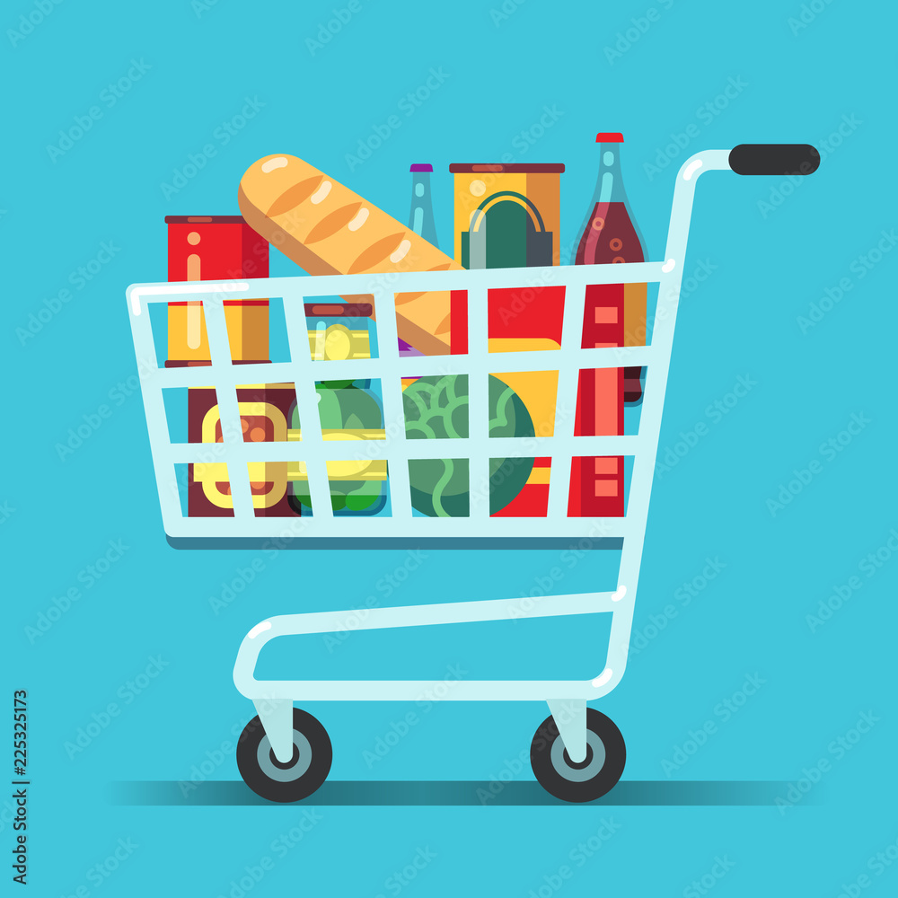
Design question #2
Where to store the contents of a customer's shopping cart? Which do you think is the best option? This decision impacts the API design.
Store cart in web server's memory?
Store cart in the database?
Store cart on the client?
One of these isn't RESTful (and doesn't scale)
One of these can lose the cart…
One of these involves extra network trip…
Notes:
Doesn't scale because it ties client to a particular web server (if we have more than one to scale)

Slide 11
GraphQL API
GraphQL = graph query language
a RESTful alternative...
Query-based vs. endpoint / function based
More powerful for clients / customers
Harder to build on the server
Notes:
Example: getCustomer(cid), getOrder(ord), getProduct(pid), …

Slide 12

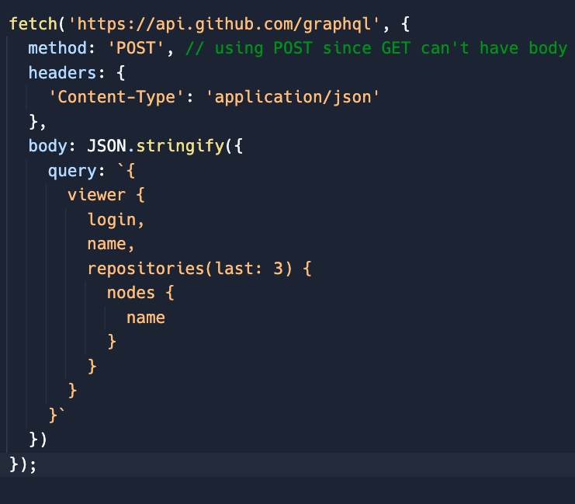

Example
GitHub supports both RESTful and GraphQL APIs
Example:
Given a username, get most-recent repos (last 3)
REST
GraphQL
Still need to parse data to get last 3 repos
https://api.github.com/users/joe-hummel
https://api.github.com/users/joe-hummel/repos
https://docs.github.com/en/graphql/overview/explorer
Notes:
fetch( ) is built into Node.js to call another web server from JS. Will demo / use later.
Compare https://api.github.com/users/joe-hummel vs. using playground and executing
query {
viewer {
login,
name,
bio,
location,
email
}
}

Slide 13
That's it, thank you!

Slide 14


Slide 15


